Slide 1

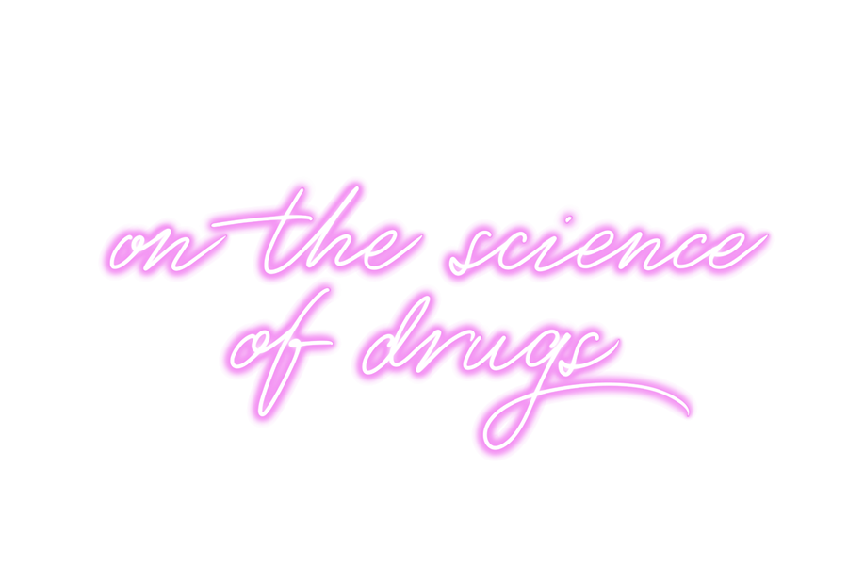


Slide 2
Lesson 3
Addiction & Recovery
jointheexchange.co.uk
drugscience.org.uk

Slide 3

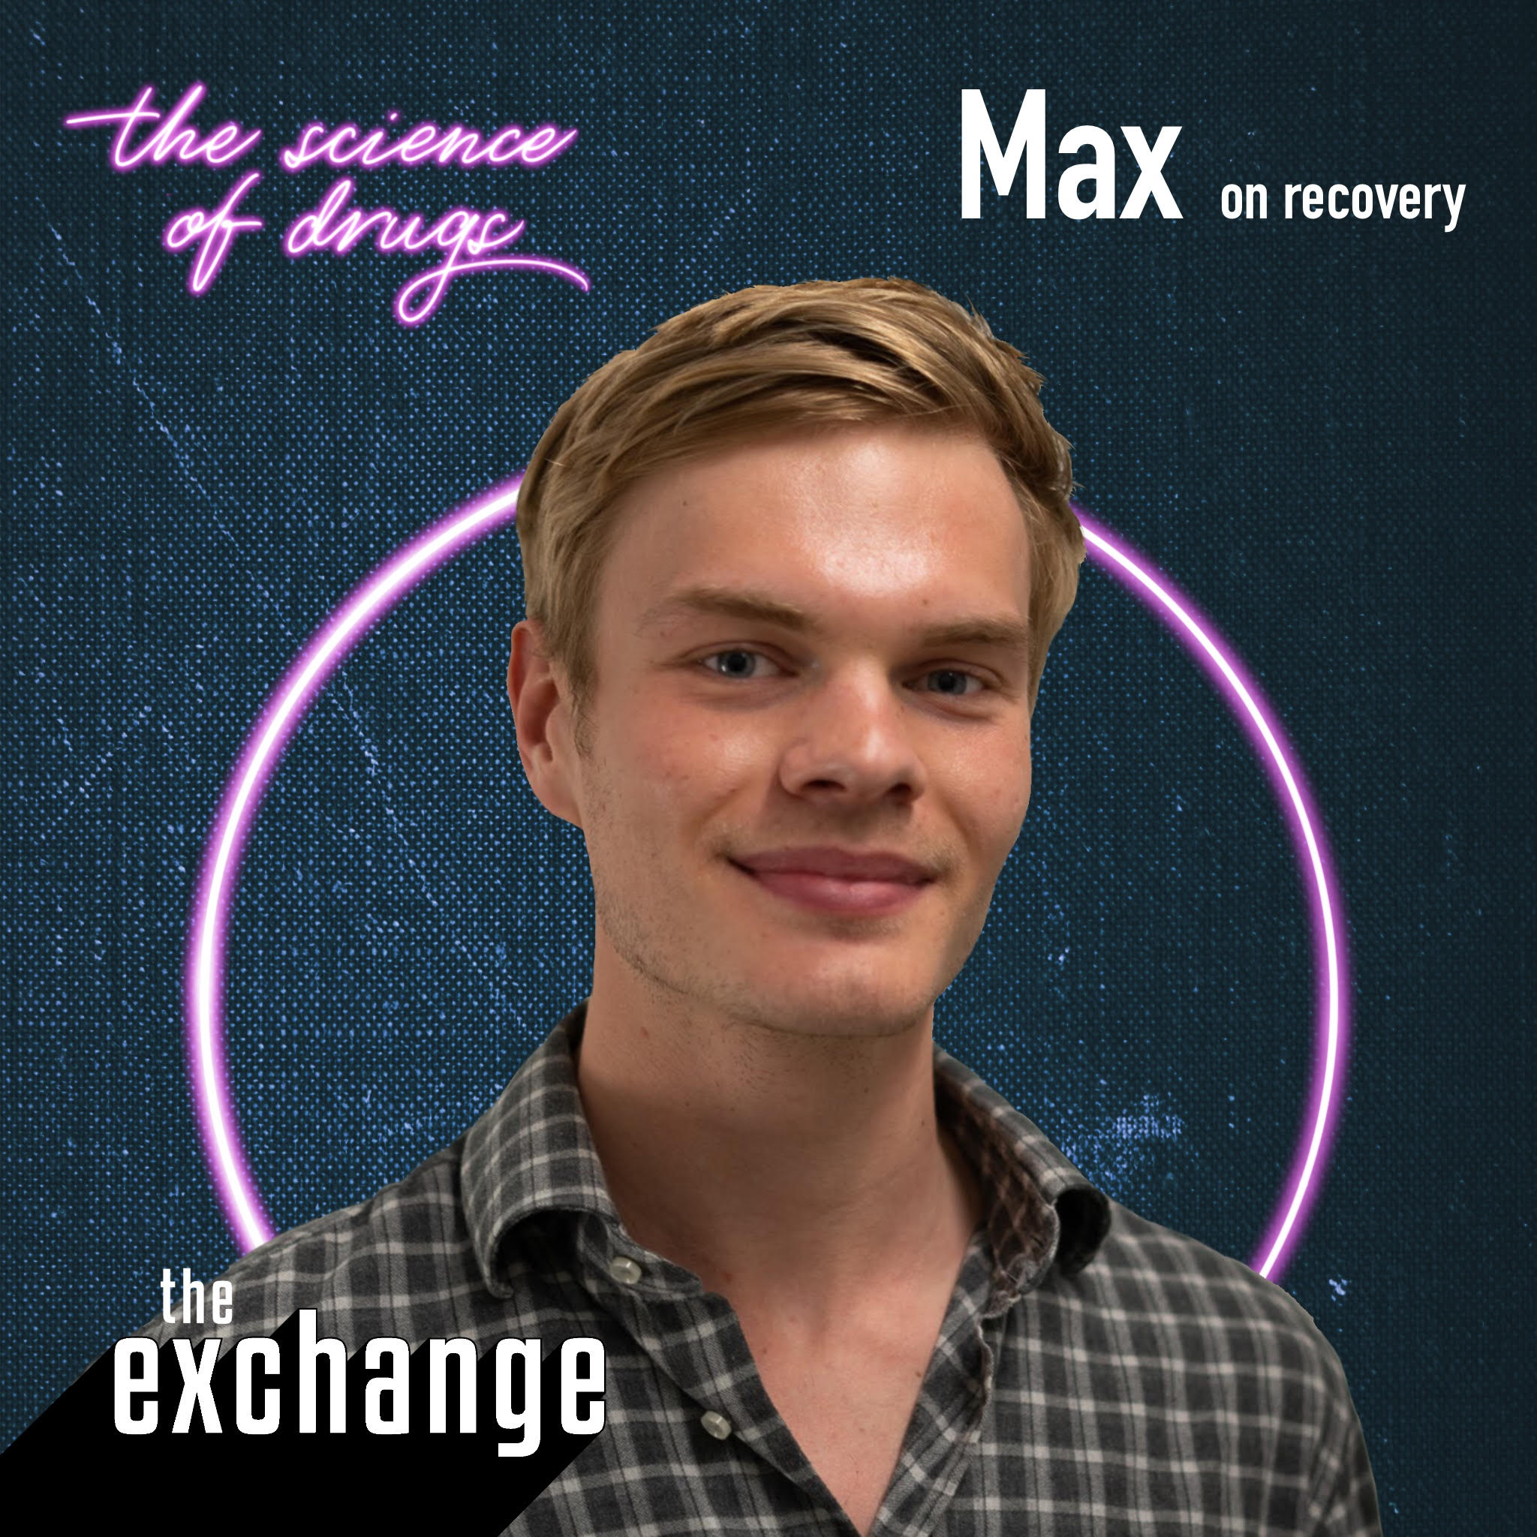
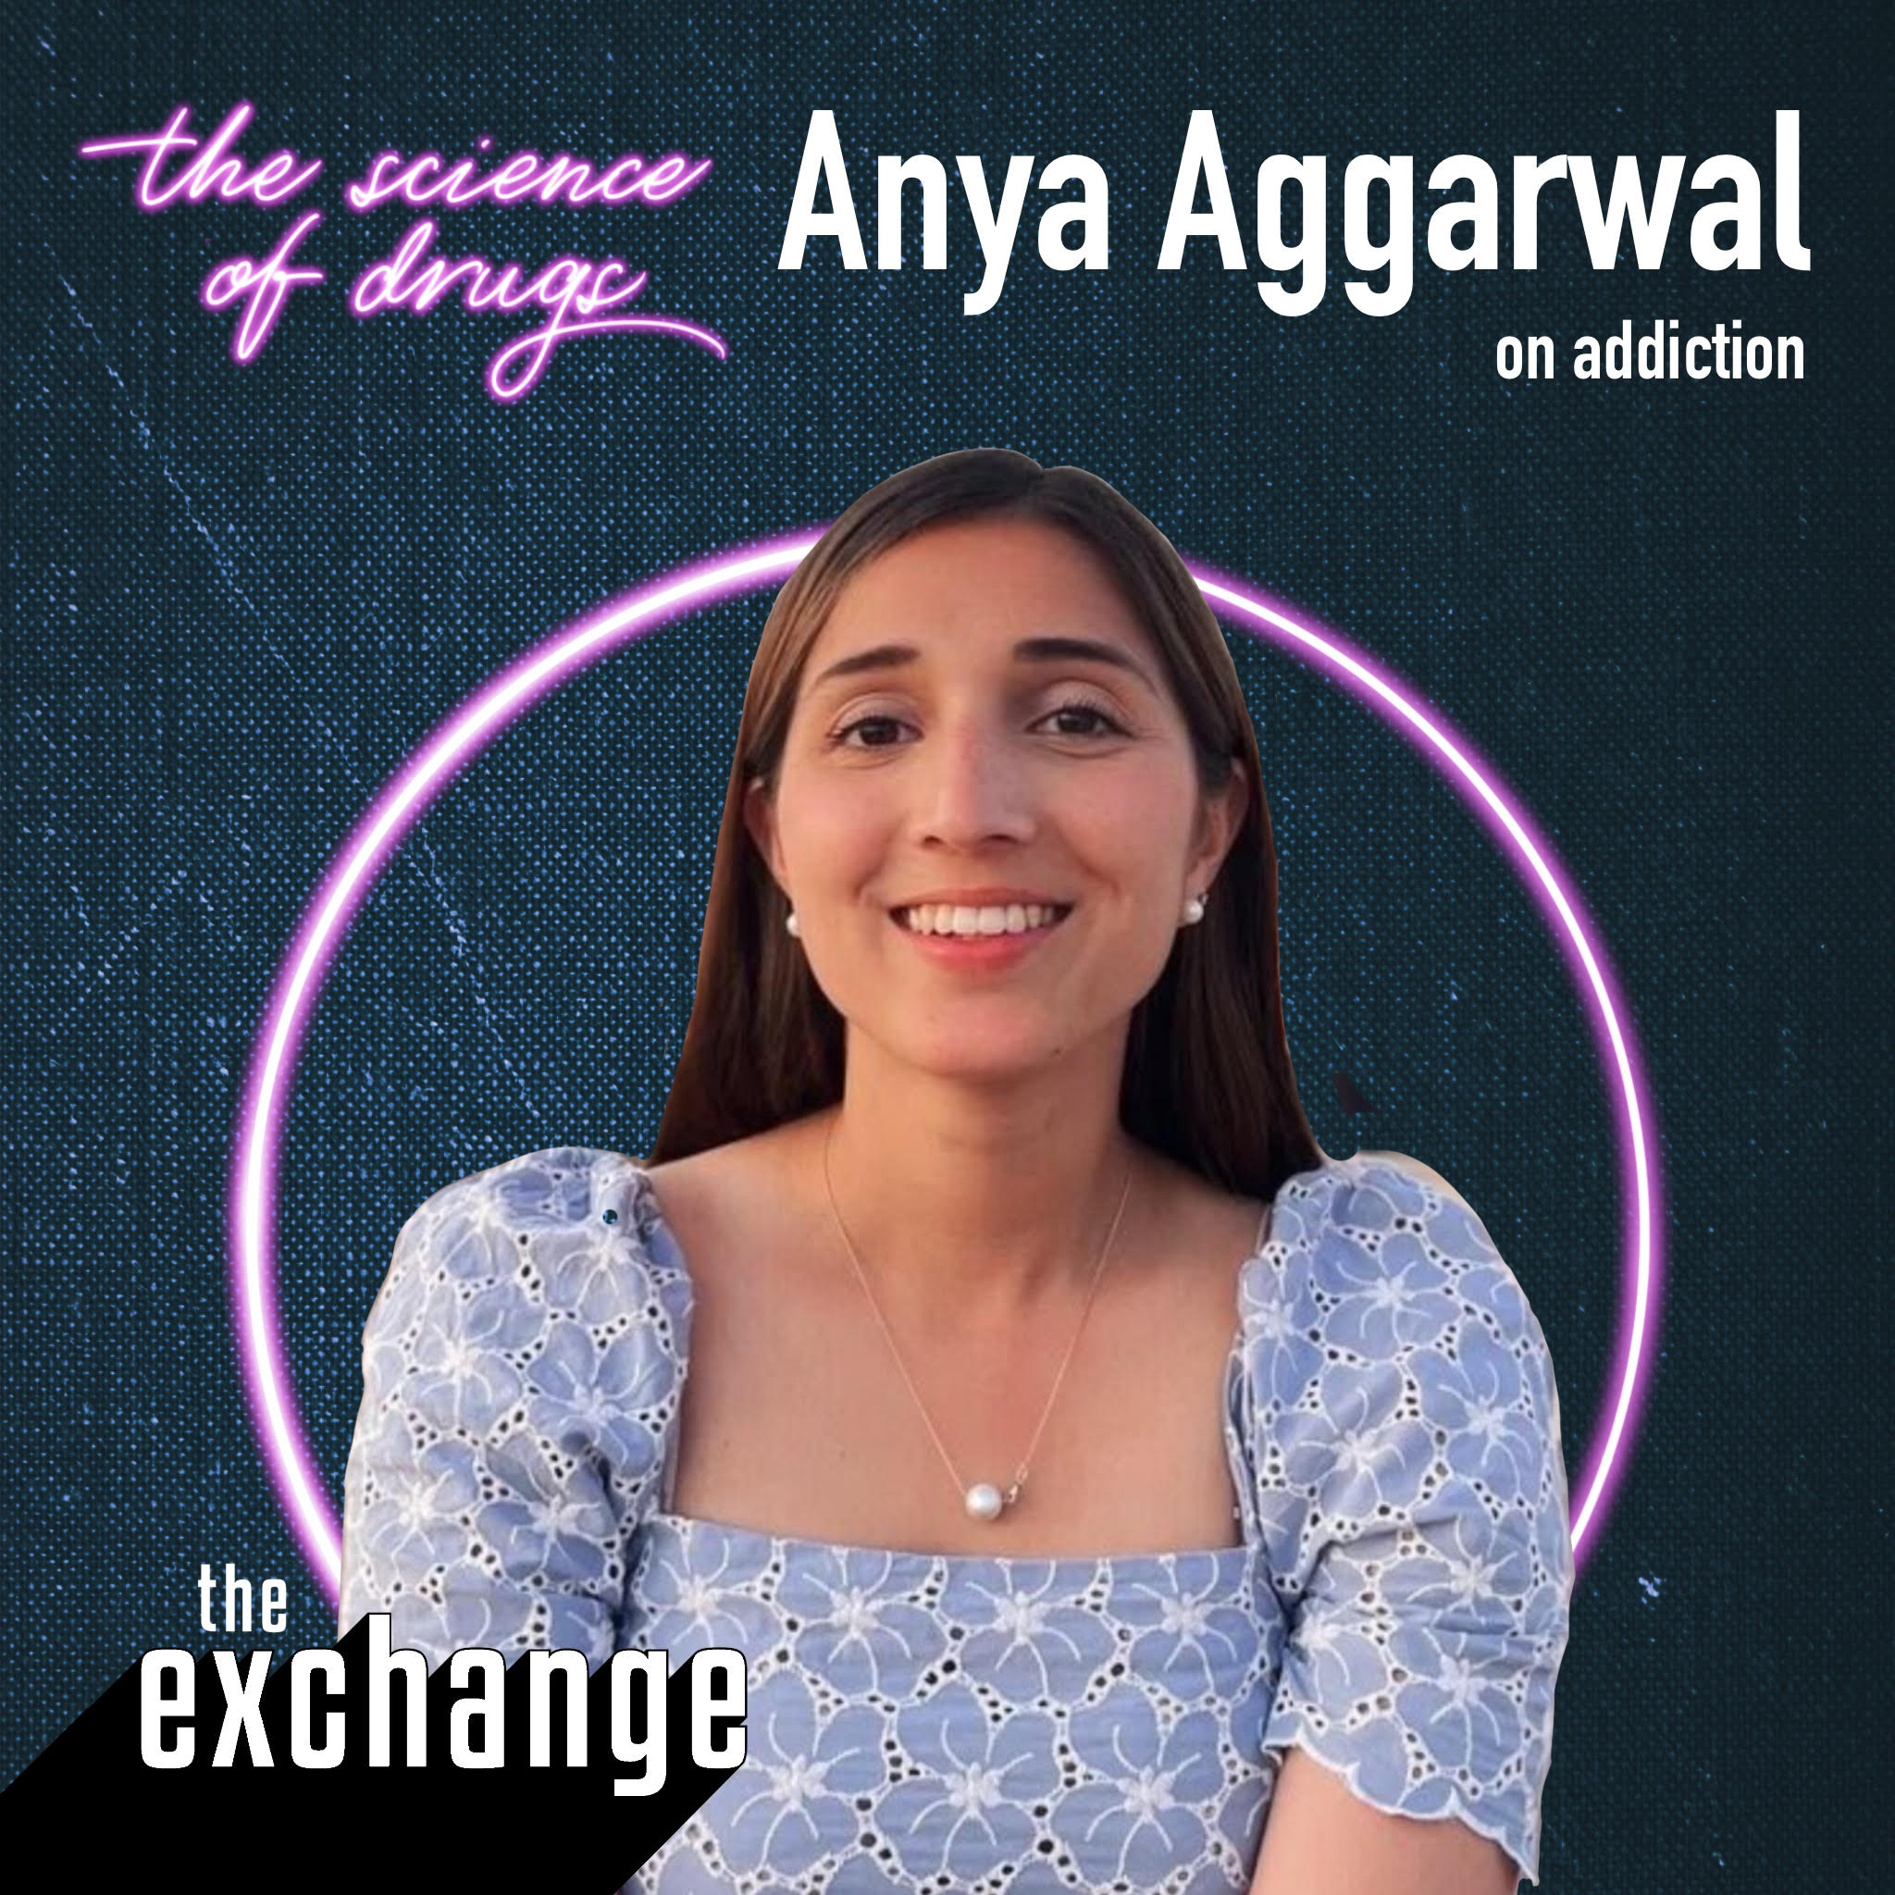
In this lesson we’ll be hearing from…
Zoe Shuttleworth
Director at It Happens Education
(RSHE provider)
Max
Max is sharing his personal story and
for this reason we are keeping his
identity discrete
Anya Aggarwal
Honorary Research Assistant Drug Science. MSc Addiction Studies at KCL. @addictionwithanya

Slide 4
What can you remember about Ketamine from last lesson?
In today’s lesson you are going to hear Max’s story of recovery from addiction to various drugs including Ketamine and we will shed light on some of the science behind addiction.
Notes:
Get pupils to refer back to their research sheet once they’ve had a go trying to remember what they can about Ketamine.

Slide 5
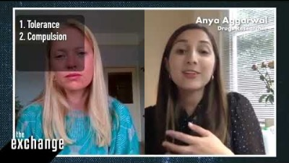
Have a go at defining addiction?
In this clip, Anya talks about the four pillars of addiction.
Withdrawal
Dependence
Compulsion
Tolerance
Notes:
Get pupils to have a go at defining it.
Then show them the four pillars and ask them if any of them included any of these words in their definition.
Then play clip of Anya explaining the four pillars

Slide 6

“Don’t do drugs because you’ll get addicted.”
True or false?
Notes:
The harms of drugs extend WAY beyond addiction and it’s important that pupils understand the complexity of addiction especially when it comes to substances that are not chemically addictive.

Slide 7





Is addiction caused by addictive drugs?
N.B The following are legal but are known to have a high addiction potential:
But remember it’s never just about the drug. There are many so-called non-addictive substances that become addictive due to the ‘set’ (the person).
For example Ketamine is addictive but there are no physical withdrawal symptoms with ketamine, so ketamine addiction is sometimes called a psychological dependence.
Sometimes e.g. nicotine
is highly addictive which is found in cigarettes and
some vapes.
Gambling
Gaming
Sex
Exercise
Notes:
Make sure pupils understand the difference between psychological and physical dependence

Slide 8
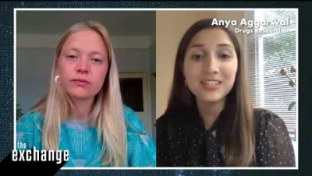
So what makes somebody addicted to a substance?
Learning Theory Views addiction as a learnt behaviour based on environmental factors
Disease model Views addiction as an illness
Choice model View drug use as rooted in personal choice

Slide 9
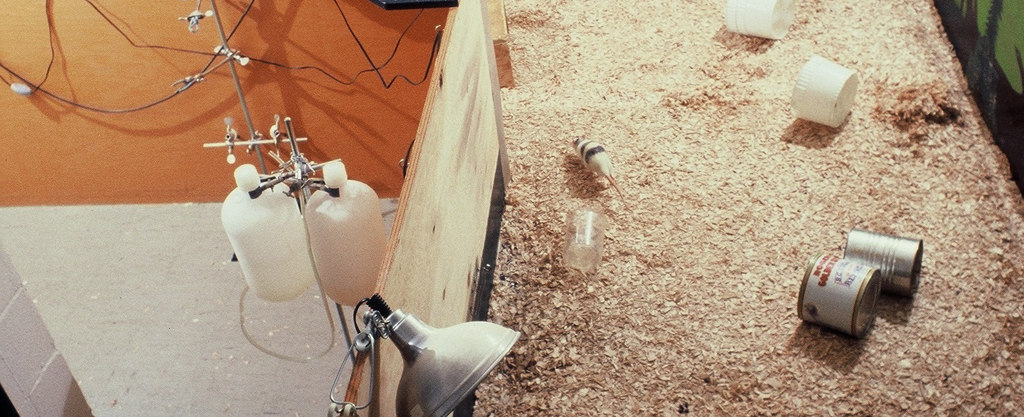

Rat Park was conducted in the late 1970s by Bruce K. Alexander.
What do you think about what
Johann Hari is saying??
Which model do you think Rat Park supports?
In this TED Talk, Johann Hari talks
about the way it reframed addiction.
Learning Theory • Disease model • Choice model
Notes:
*The video refers to pornography and sex in passing

Slide 10
Over to you…
Learning Theory Views addiction as a learnt behaviour based on environmental factors
Disease model Views addiction as an illness
Choice model View drug use as rooted in personal choice
Which model/combination of models do you think is most helpful when tackling addiction? And why?

Slide 11
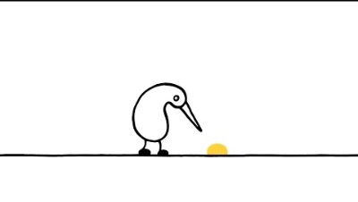
What does this video tell us about the emotions involved in being addicted to drugs?

Slide 12
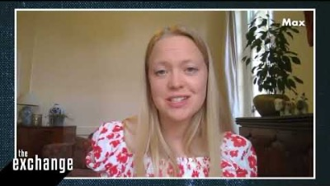
Watch the start of Max’s story
As you watch it, consider which factors contributed to Max’s addiction to substances?
Notes:
Draw out themes from this story that might be useful for the class.

Slide 13
With the person next to you, jot down all the words that come to mind when you see the word:
ADDICT*
* Addict is often seen as a pejorative word and shouldn’t be used when referring to people addicted to drugs.
Notes:
Gather some of the words and write them on the board. Draw out stigma associated with addiction. Stigma associated with addiction tends to put the onus of addiction on the person – it’s their fault rather than ‘they are unwell.’ Whilst we cannot totally remove free will, addiction is an illness.

Slide 14

Why is Max happy to call himself an addict and which model of addiction does he reject?

Slide 15
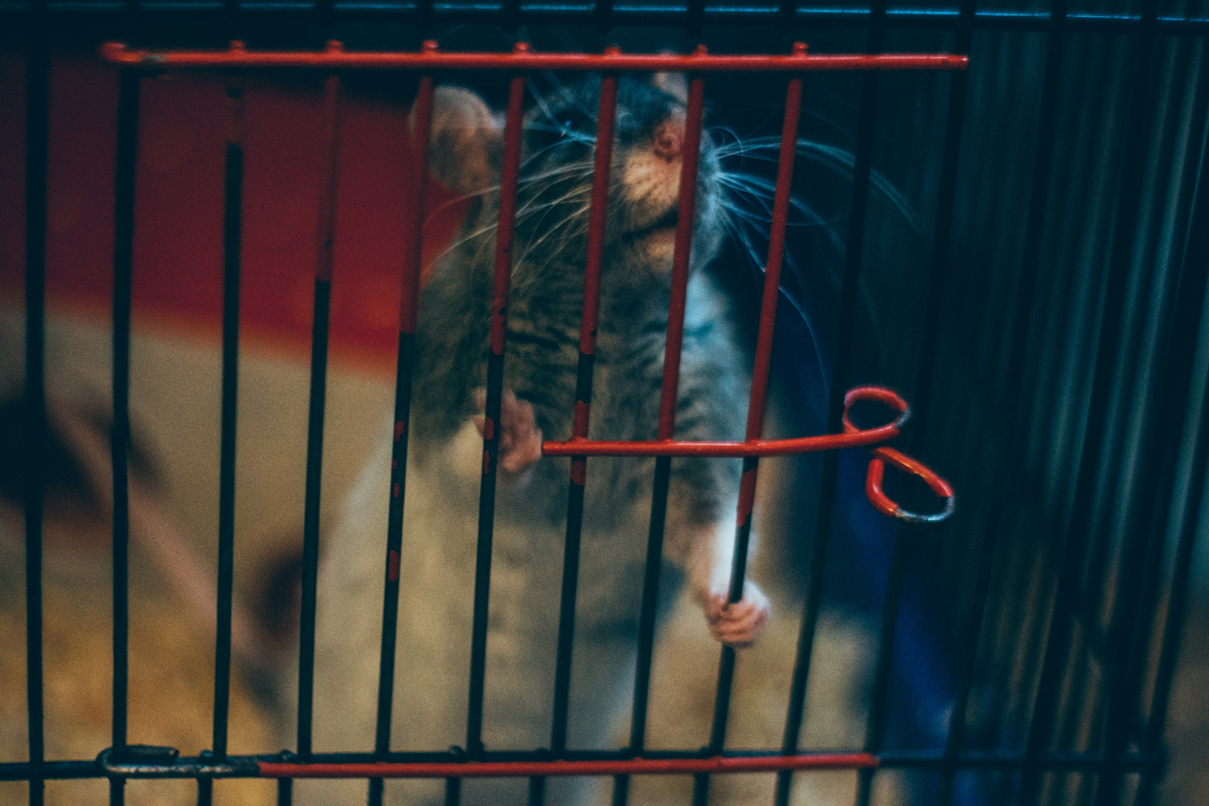

‘What if addiction is about your cage?’
Take 5 minutes with your partner and write or draw your ideas next to the cage
If you were to design an environment that would help an addict recover from drug misuse, what would it look like?

Slide 16

Max’s recovery…
As an addict, Max’s recovery isn’t a single moment, it’s a lot of hard work over a long period of time.
What sort of things does he do to help this?

Slide 17
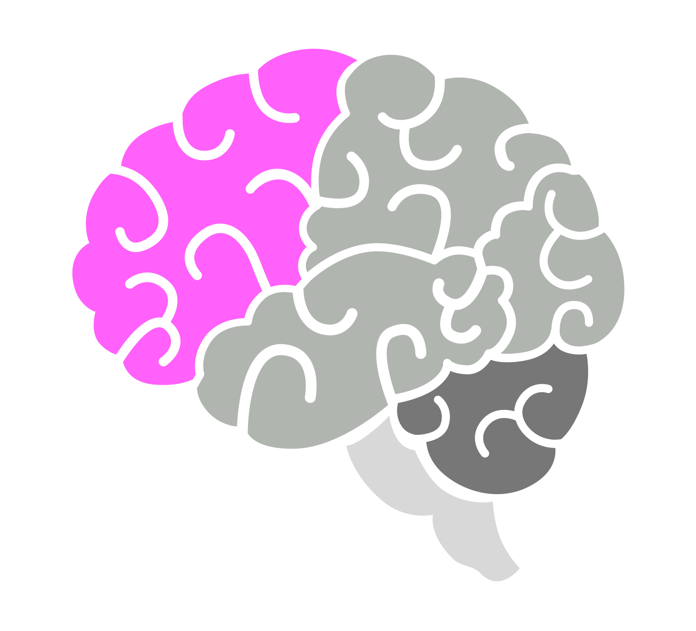
Adolescence and addiction
This part of the brain doesn’t develop until mid-20s.
Chances are your frontal cortex is still growing!
THE PREFRONTAL CORTEX
The prefrontal cortex is in charge of careful decision making. If it is still underdeveloped, you may be more likely to seek out highly stimulating and rewarding activities whilst being less aware of potential risks.
How might an underdeveloped prefrontal cortex make someone more susceptible to addiction?

Slide 18
Signs and symptoms of substance misuse…
If you answer yes to these questions, it might be that you need help:
Do you lie about drug* use?
Do you take drugs alone?
Have you ever tried to quit and been unable to?
Do you continue taking drugs despite negative consequences?
* ’drugs’ include legal drugs like alcohol, smoking and vaping too.

Slide 19


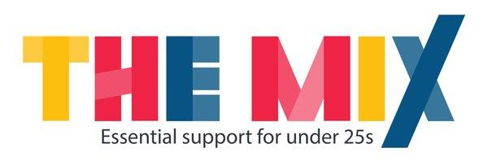






dsmfoundation.org.uk
drugscience.org.uk
talkaboutalcohol.com
themix.org.uk
ithappens.education
nhsgo.uk
riseabove.org.uk
youngminds.org.uk
Notes:
Modify to include school support.
Leave up on the screen and then send around to your class after the lesson so that they know where to go if they need further help and support.

